Slide 1
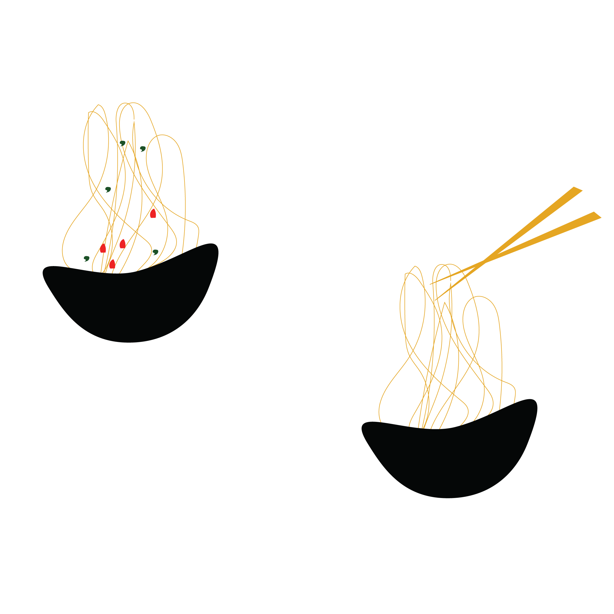
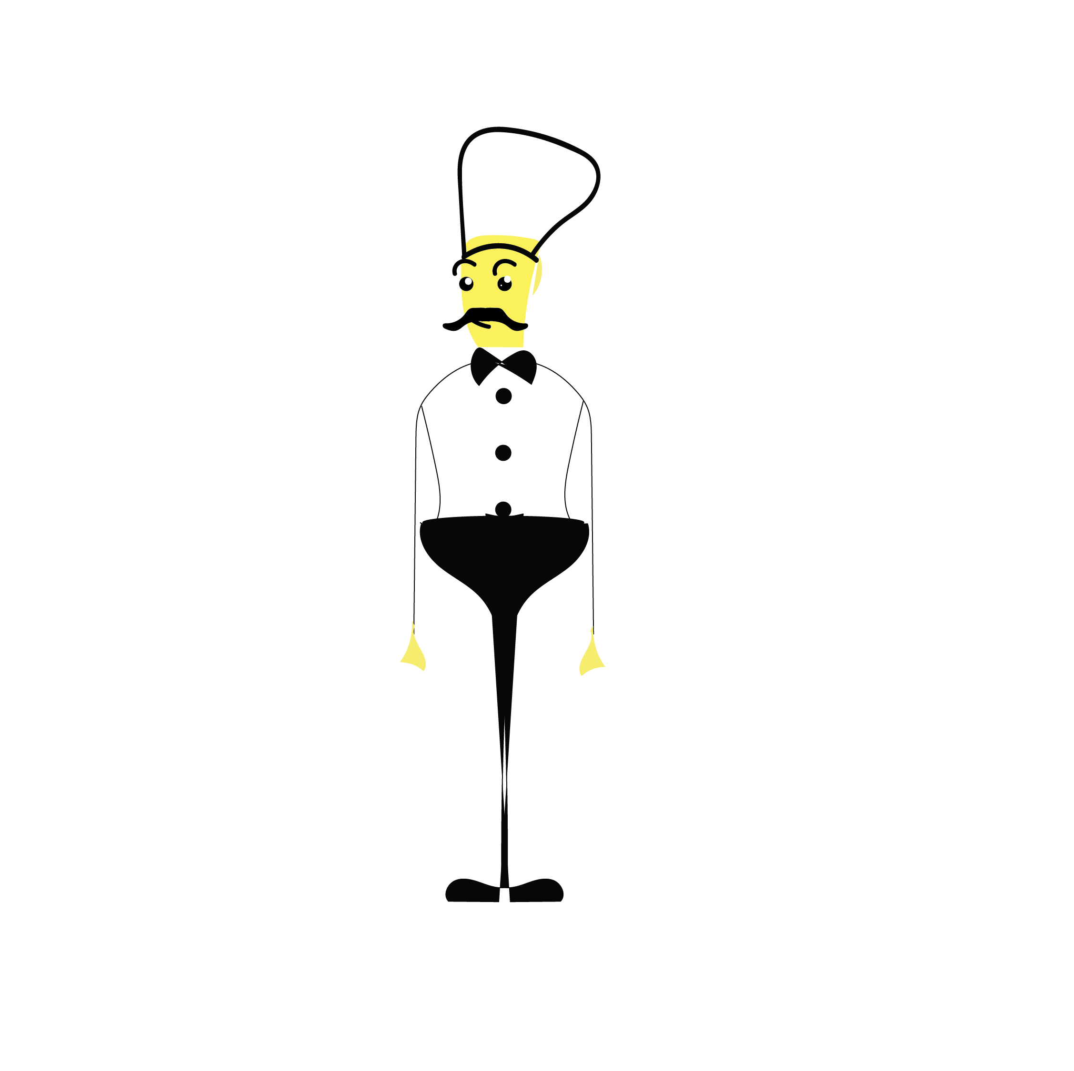

Foundation Project - 1
Submission by GROUP 10
Group Members:
  Deep Kamal Singh (12020053)
  Kshitij Sharma (12020062)
  Mohua Sinha (12020015)
  Nidhi Srivastava (12020078)
  Soumaya Ranjan (12020060)

Slide 2

Introduction
Food Recommendation Systems and Scope of Improvements
  Consumers now have a variety of food choices, and comfort of Home delivery along with dine-out.
  Abundant outlets for dining out or home delivery,
  Several food aggregator sites and apps to compare restaurants based on ratings, safety and hygiene, deals, and distance etc.
  So much data available, however there is a scarcity of right data analysis to infer actionable insights
  Seasonal moods affect consumer tastes and preferences
  Little to no personalization on food suggestions
  Limited tracking on gastronomical compatibility
  Need of the Hour
  Accelerated Customer Satisfaction
  Realtime 360° Feedback mechanism
  Enhance profitability and measured economic success
  Unexplored potential
  CRISP-DM
  Using the big data
  Distributed Computing
  Mathematical Modelling
Notes:
we as a group are trying to bring about the changes that could accelerate the customer satisfaction and thrive the businesses as well.

Slide 3
Business Understanding
Business Problem
Present food recommendation engines are not effective
Significant churn on the account of limited/sub-optimal choices to customer, impacting future sales and retention
Business Objective
Maximize monthly sales for restaurants and food aggregators by turning one-time customers into repeat customers
Business Constraints
Minimize consumer fatigue by providing most optimal choices.
Minimize searching time for preferred choices

Slide 4
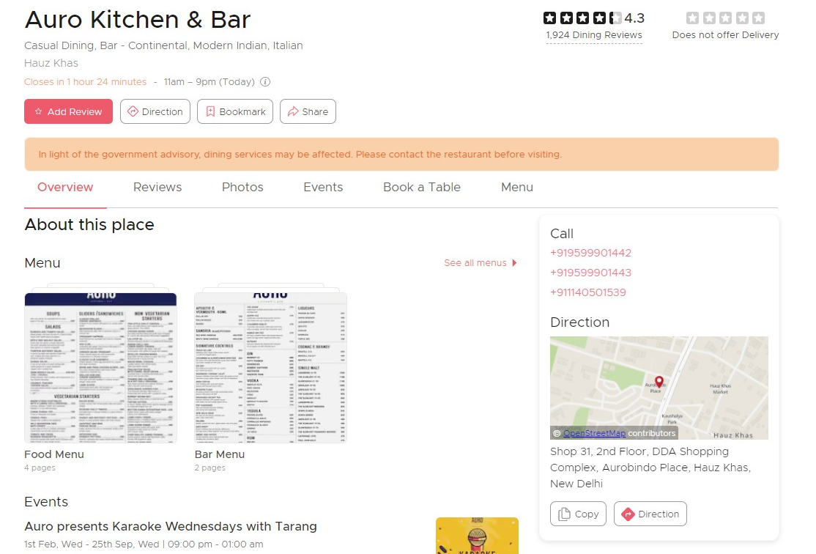
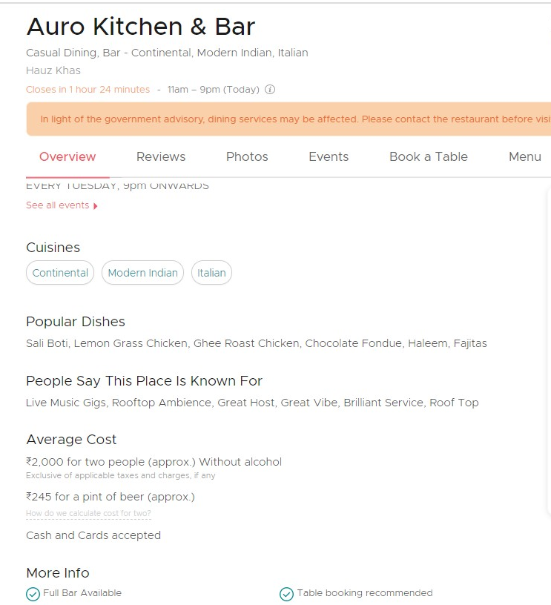
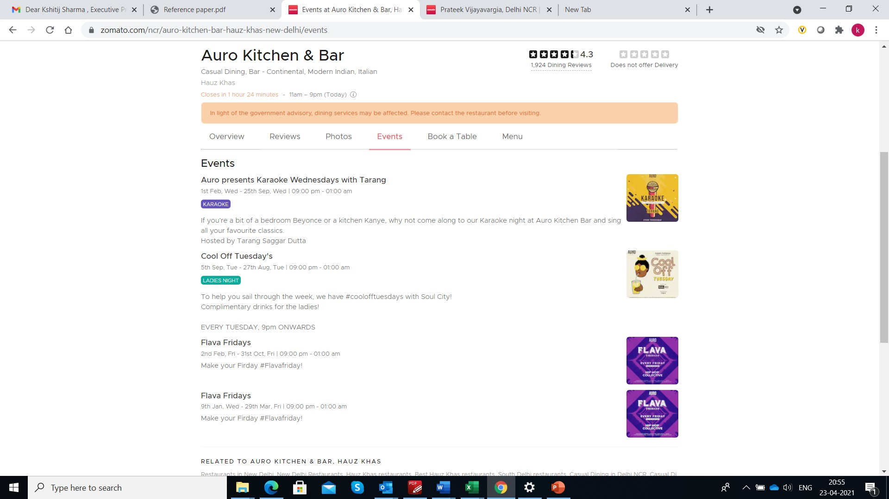
Data Requirements
Data Attributes
Data Sources
Attribute/features | How will it help?
Food outlet location | Geographic region along with review date will help to determine the seasonality
Cuisines/Menu information | Type of cuisines provided by the food outlet
Popular dishes | Help to determine the preferences for the dishes for the outlet
People Say This Place Is Known For | Help to determine the reasons for visiting the outlet and possible mood
Events | Help to determine the mood on the day by linking with the review date
Ratings/Reviews | To determine the likeability of a dish and likeability of the outlet
Review date | +2 days can be considered as the possible visit date and can help to determine the seasonality impact as well as mood by relating to events around those dates
Reviewer info | To determine the demographics of the reviewer, any allergies, food preferences

Slide 5
Data Collection & Understanding
The data collection process would be done through two modes:
Unstructured Data: Domain crawling (done for a geography and for a one-year period for dataset.)
Structured data: (personalised survey pan-India level targeting 200+ respondents for food preferences)
Understanding data collected to further refine our model includes:
Performing test of linear regression between food-dish based review/rating and customer.
Mapping seasonal, taste, nutrient’s data points to customer.

Slide 6
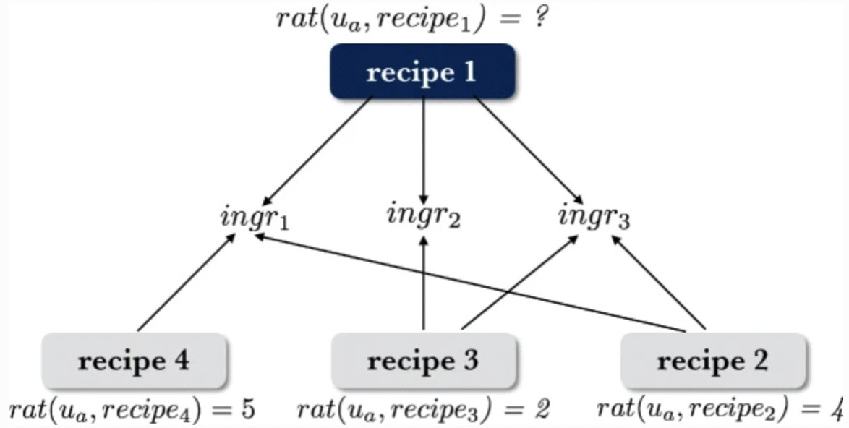
To create a recommendation framework, we will use MCDA – Multi criteria decision analysis matrix match, in which we will determine the top driving factors for a customer's food choice and cross match it with the collection of attributes of available food choices (dishes).
Data Preprocessing
Customer food preference indices
Nutritional compatibility matrix
Food hypersensitivity reactions matrix
Flavor preference matrix
Data Cleaning and Curation
Identifying and monitor for errors in data
Process formation and preparation of SOP for continuous feed
Duplicate, redundant and non-usable data identification and removal
Detailed Data Analysis and process-oriented data structuring
Inter process communication
Ref. IEEE Paper
Food Dish composition matrix
  Ingredient’s list – composition
  Complimentary compatibility
  Seasonal/weather compatibility score – humidity, temperature data
  Customer ratings and order history – likelihood pairs

Slide 7
Implementation Model
To build a Recommendation system, will follow MCDA – Multi criteria decision analysis matrix match.
This will help to figure out top driving factors for a customer’s food preference.
Public surveys to provide data to determine the preferences based on taste, allergic and health conditions.
Capture the preferences from food reviews from social platforms data.
Perform matrix matching of the ingredients of each dish, based on our recipe reference data.
Further learning in this direction led us to form the data points or features, which we will feed as input to our model.
Our target is to achieve prediction score (say >~0.90) from the Multinomial Naïve Bayes model.
Based on the prediction score, will increase our training dataset, if required, to further tune our model.
List of References:
An overview of recommender systems in the healthy food domain | SpringerLink
Data Cleaning Steps
A Food Recommender System Considering Nutritional Information and User Preferences | IEEE Journals & Magazine | IEEE Xplore

Slide 8
THANK YOU
GROUP 10
  Deep Kamal Singh (12020053)
  Kshitij Sharma (12020062)
  Mohua Sinha (12020015)
  Nidhi Srivastava (12020078)
  Soumaya Ranjan (12020060)

